Slide 1
Developing Integration Solutions using Microsoft BizTalk Server 2013
Day 2 Key Learnings

Slide 2


Publish Subscribe
Receive Port
Orchestration
Send Port
Message Box
Notes:
In a publish/subscribe design, you have three components:
Publishers
Subscribers
Events
Publishers include receive ports that publish messages that arrive in their receive locations, orchestrations that publish messages when sending messages or starting another orchestration asynchronously, and solicit/response send ports that publish messages when they receive a response from the target application or transport.
Subscribers include send ports and orchestrations as well as request/response receive ports that subscribes to response messages to send back to the caller.

Slide 3
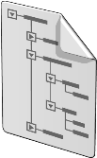

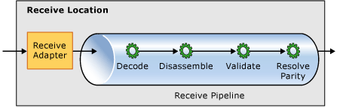
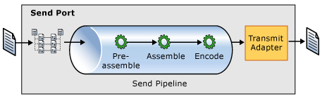
Context based Routing
BTS.ReceivePortName = ”RcvOrder”
RcvOrder
SndOrder
MsgBox

Slide 4
Content based Routing
CustomerType = ”VIP”
SndOrder_VIP
RcvOrder
MsgBox
Order.xml
SndOrder_Default
CustomerType != ”VIP”

Slide 5
Failed Messages
ErrorReport Properties
Failed Messages gets placed in the Suspended queue
State is either
Suspended (Resumable) or
Suspended (Non-Resumable)
Handling message failure in Ports
Suspend or
Select the checkbox: Failed Message Routing
FailureCode*
FailureCategory*
Description
MessageType*
ReceivePortName(*)
InboundTransportLocation(*)
SendPortName(*)
OutboundTransportLocation(*)
ErrorType*
RoutingFailureReportID*

Slide 6
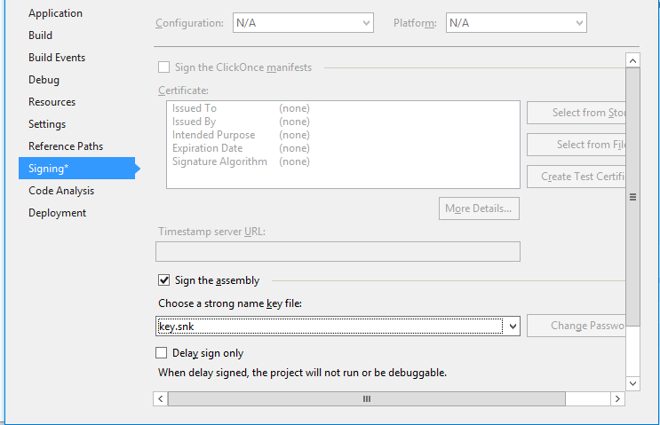
Strong names
Strong named assemblies
Are signed with a digital signature key.
Can call only other strong named assemblies.
Ensure unique and reliable identification of assemblies.
Are required by the GAC and BizTalk Server.

Slide 7

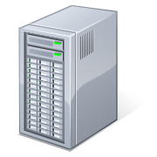

Deploying assemblies to BizTalk Server
Non-BizTalk assemblies
BizTalk Server
Install
GAC
BizTalk Assemblies
Install
Import
Configuration Database

Slide 8
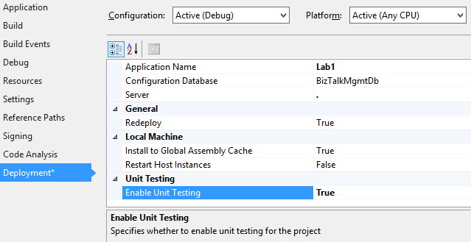
Unit Testing BizTalk Server artifacts
Creating Unit Tests
Must be enabled on project level to be used.
Available for schemas, maps and pipelines.
Requires Visual Studio Test features, or some other test application like NUnit/BizUnit.

Slide 9



Composing loosly coupled applications
SAP.Orchestrations.Order
Orchestrations
SAP.Transformations.Order
SapOrder_to_NavisionOrder
SAP.Schemas.Order
NavisionSchemas.Order
Schemas
Schemas

Slide 10


Version strategies
Single Version
Easy Control
Require downtime
Complex deploy
Multi Version
No downtime
Easy deploy
Require cleanup
Require disipline

Slide 11
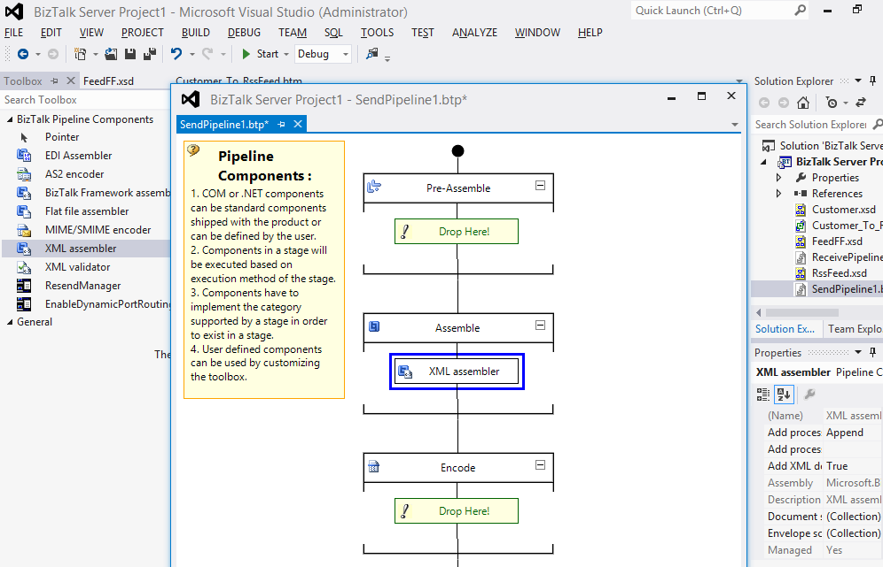
Using the Pipeline Designer
Toolbox
Design Surface

Slide 12

Custom Pipeline Components
public IBaseMessage Execute(IPipelineContext pc, IBaseMessage inmsg)
{
inmsg.Context.Promote("Customer", "http://MyNameSpace", "Vandelay Industries");
inmsg.Context.Write("Customer", "http://MyNameSpace", "Vandelay Industries");
}

Slide 13
Course Outline
Module 1: Introduction to BizTalk Server
Module 2: Schemas
Module 3: Maps
Module 4: Testing and Deploying Projects
Module 5: Pipelines
Module 6: Routing
Module 7: Adapters
Module 8: Web Services and WCF
Module 9: Introduction to Orchestrations
Module 10: Applied Orchestration Techniques
Module 11: Business Activity Monitoring
Module 12: Integrating Business Rules
Module 13: Deploying and Managing Applications
Module 14: Working with Workflow and AppFabric
Wednesday

